Slide 1
Climate Change Scenarios
The problem
Sources
Mechanisms
Possible futures
Consequences
The solution

Slide 2
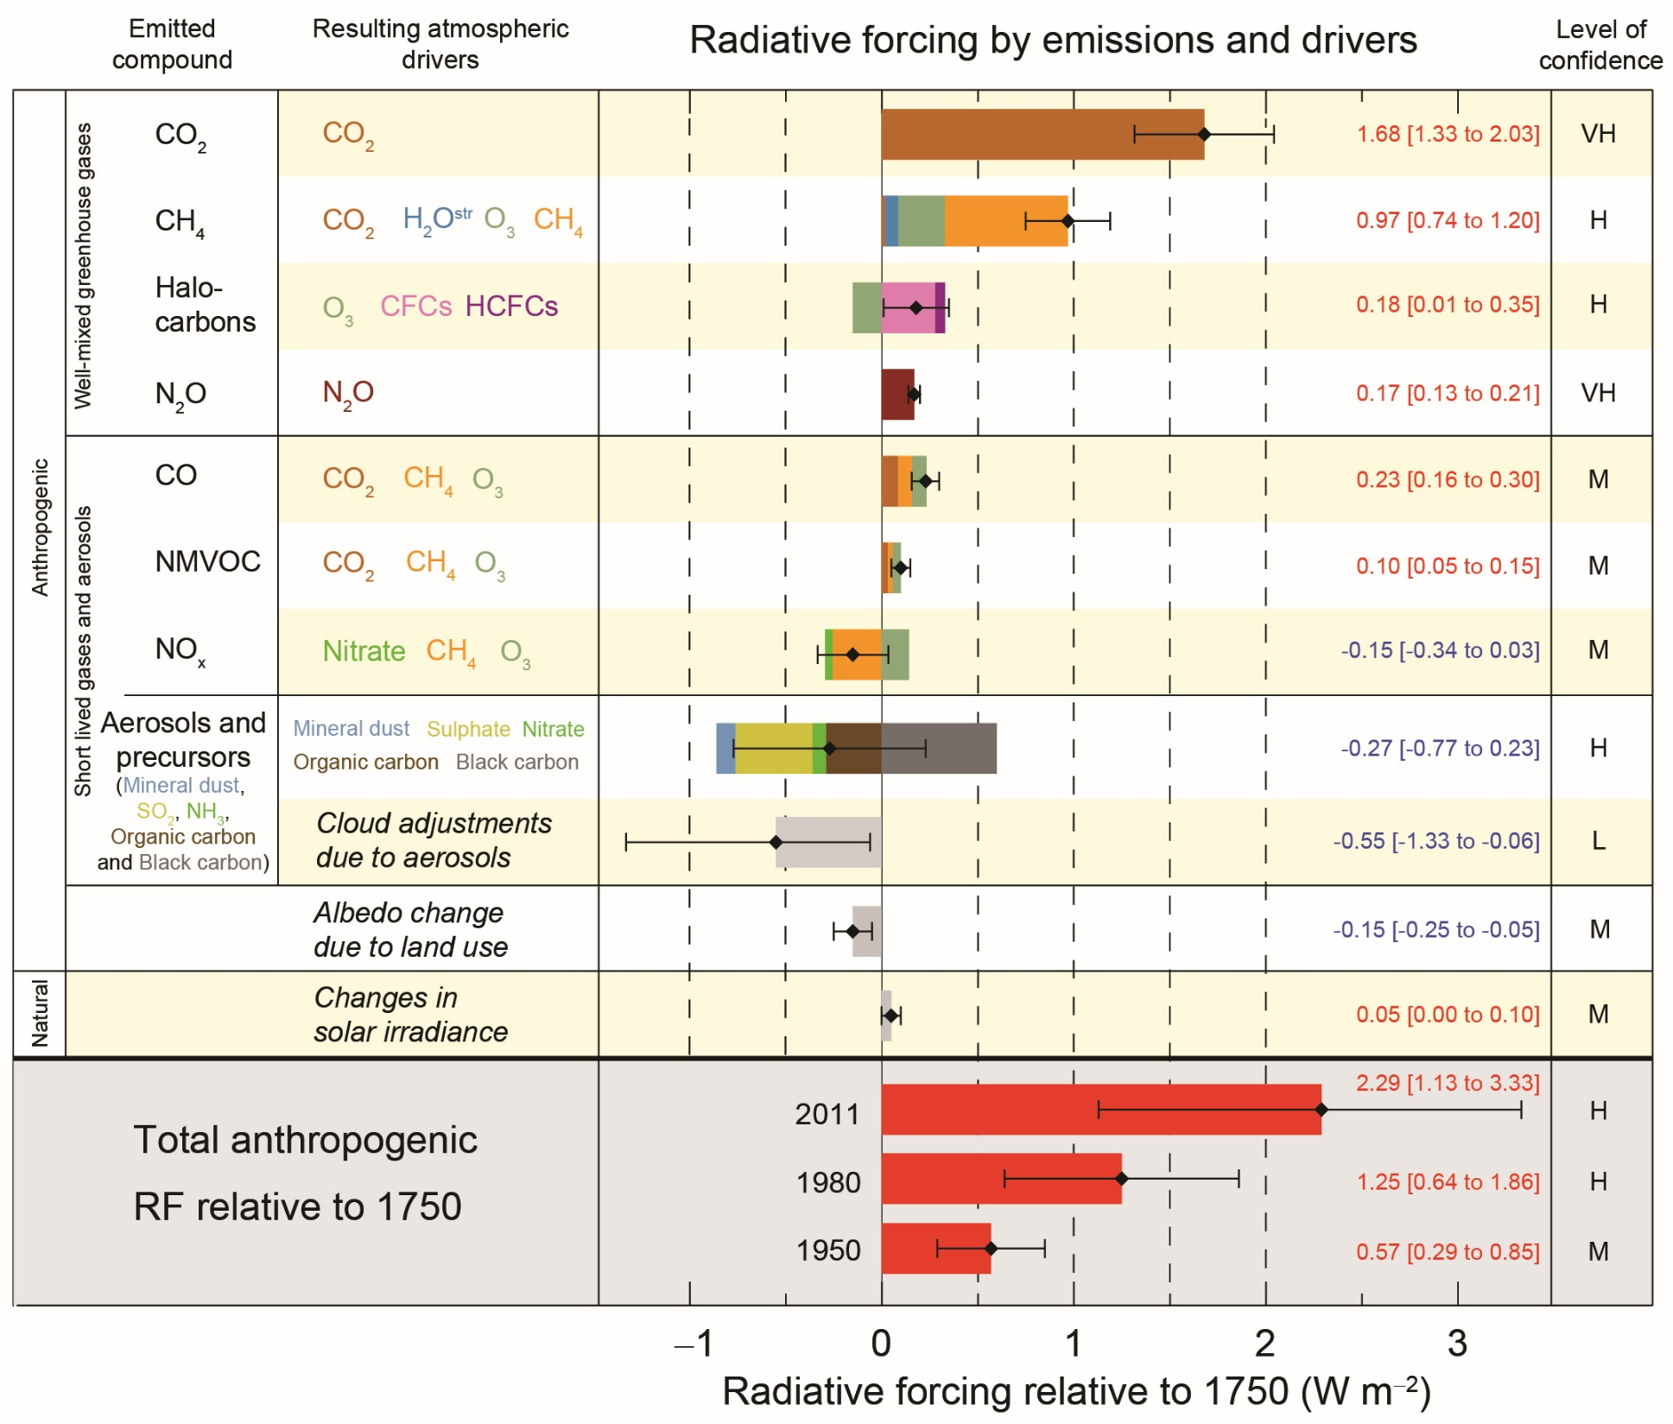

Slide 3
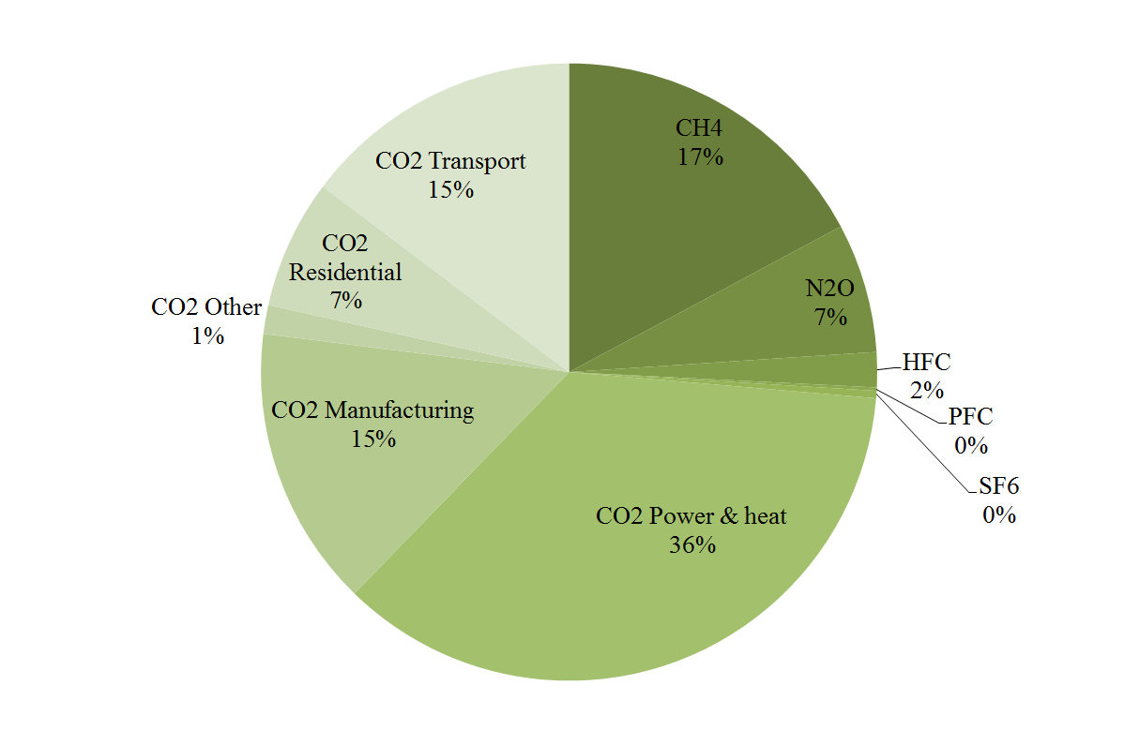

Slide 4
Sources of greenhouse gas emissions
Carbon dioxide
Combustion of fossil fuels
Land use change
Cement production
Methane
Ruminants
Paddy rice
Waste
Leakage
Nitrous oxide
Agriculture
Other gases
Specialised industry

Slide 5
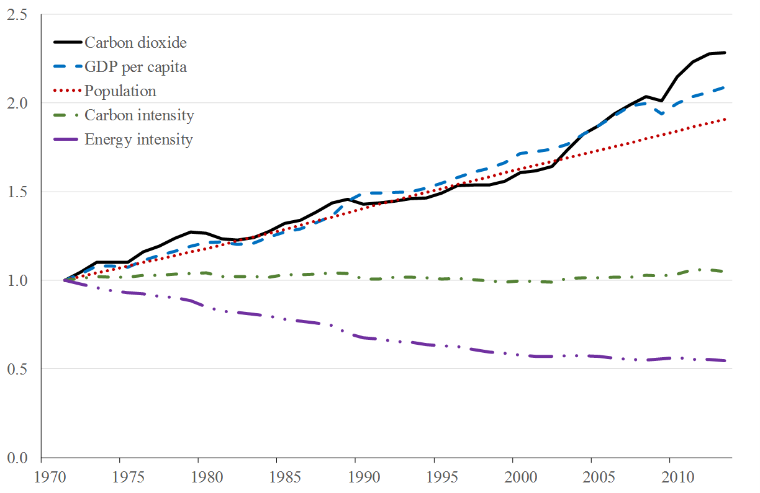
Emission trends

Slide 7
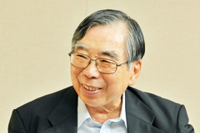
Emission scenarios
Kaya identity
So, we need to predict how many people there will be in the future, how rich they will be, how much energy they will use, and what sort of energy; how much waste they will generate and how they will dispose of it; and what they will eat and where that food will be grown
And over a period of 100 years or more
Scenario uncertainty is compounded by uncertainty over climate and carbon cycle

Slide 8
